Slide 1

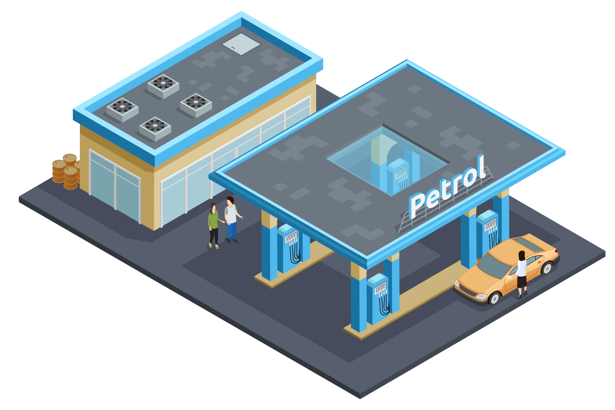





PETROL PUMP MANAGEMENT SYSTEM
By – PERPTUAL MOTION
GROUP MEMBERS | ID
RAKIBUL ISLAM | 2020000000049
NUR MOHAMMED RAJIN | 2020000000121
MD ZUNAYED | 2020000000135

Slide 2
TABLE OF CONTENT
INTRODUCTION An overview of the project and its purpose.
INTRODUCTION
GOAL OF THE PROJECT state the goal of the project and what it aims to achieve
GOAL OF THE PROJECT
CASE STUDY Provide a real-world example of the problem the project is addressing
CASE STUDY
PROBLEM STATEMENT the problem that the project is trying to solve
PROBLEM STATEMENT
ISSUES/LIMITATION Identify any limitations or issues that the project will face
ISSUES/LIMITATION

Slide 3

TABLE OF CONTENT
OBJECTIVE the specific objectives of the project.
OBJECTIVE
FEASIBILITY ANALYSIS Analyze the feasibility of the project in terms of technical, operational, and economic factors
FEASIBILITY ANALYSIS
COST-BENEFIT ANALYSIS Evaluate the costs and benefits of the project
COST-BENEFIT ANALYSIS
TYPE OF STAKEHOLDERS Identify the different types of users that will be impacted by the project
TYPE OF STAKEHOLDERS
FUNCTIONALITY GROUPING
FUNCTIONALITY GROUPING Group the functionality of the project according to the type of users,

Slide 4
TABLE OF CONTENT
NFRS
NFRS Identify the non-functional requirements of the project
OVERALL CONSTRAINTS
OVERALL CONSTRAINTS Identify overall constraints that the project will face
ERD Provide an ERD to show the relationships between entities in the project
ERD
UCD
UCD Provide a UCD to show the interactions between users and The system.
ACTIVITY DIAGRAM
ACTIVITY DIAGRAM Provide an activity diagram to show the flow of activities in the project
GANTT CHART
GANNT CHART Provide a Gantt chart to show the schedule and timeline of the project.

Slide 5


INTRODUCTION
WELCOME
PROJECT AIM
EMPLOYEE ASSIST
Our project aims to streamline and automate the processes involved in running a petrol station
.
The system is designed to assist employees in their day-to-day tasks and provide a comprehensive solution for managing the petrol pump's daily records
GOAL
Welcome to our presentation on the Petrol Pump Management System
Our goal is to increase efficiency and productivity, leading to better management and profitability
ADDITIONALLY:
The manager will be able to monitor and manage various aspects of the petrol pump's operations, including staff attendance, fuel sales, financial transactions, and more.
In this presentation, we will be discussing the goal of the project, case study, problem statement, objectives, and more.

Slide 6

GOAL OF THE PROJECT
The Petrol Pump management system project's primary goal is to computerize the petrol pump's reporting work, which is currently done manually.
This aims to ease the workload of the manager and make it easier for them to maintain daily records.
Additional goals include: increasing efficiency, providing real-time information, improving accuracy and reliability of financial transactions, providing a user-friendly interface, and enhancing overall performance by monitoring fuel inventory.
The project aims to help the manager manage the petrol pump more efficiently, accurately, and productively.

Slide 7

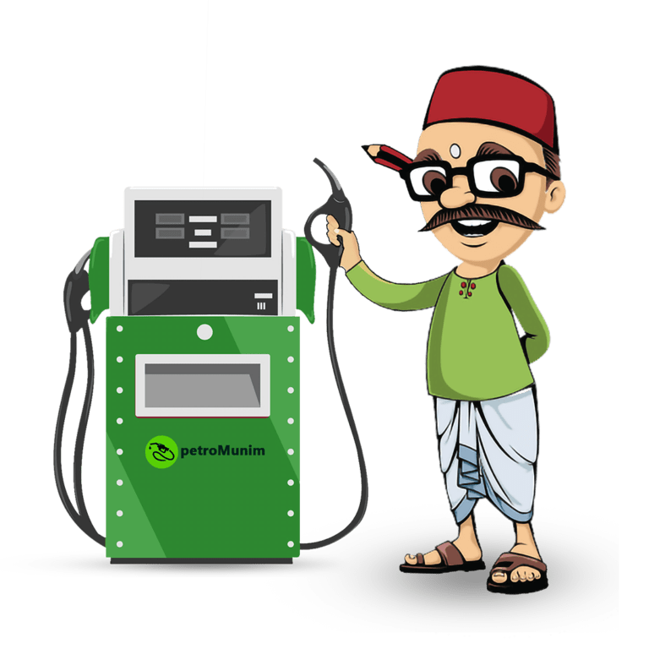
CASE STUDY
INTRODUCTION
CURRENT STATE
SOLVING ISSUE
Mohammad Bahar Uddin is the owner of a petrol pump located in the main road area in Netrokona.
The petrol pump owner facing challenges due to increasing sales and complexity of the business. The current manual process used at the petrol pump is causing these challenges.
Petrol Pump management system automates sales and transactions, and improves performance and profitability.

Slide 8





PROBLEM STATEMENT
Challenges in Managing the Petrol Pump.
MANAGING
INFORMATION
CONCLUSION
Difficulty in managing and monitoring employee attendance and work.
Lack of real-time information about petrol pump operations
The need for a more efficient and accurate solution for managing the petrol pump is crucial for improving performance and profitability
TRACKING
TIME-CONSUMING
MAINTAINING
Difficulty in accurately tracking fuel sold and inventory levels.
The time-consuming process of recording and calculating sales data.
Difficulty in maintaining accurate financial records and reporting

Slide 9


ISSUES AND LIMITATION
Time-consuming and error-prone manual system AND Inconsistencies in data.
Data stored in a record book is prone to corruption and difficult to retrieve.
Lack of proper pricing information
Difficulty in managing employees
Lack of security in the manual system, leading to unauthorized access to sensitive information.

Slide 10






OBJECTIVE
Design and develop a user-friendly web application for managing the petrol pump
Automate sales and money management for increased efficiency
Solve current manual system limitations for improved performance and profitability.
FEATURE
DATABASE
APPLICATION
SALES MANAGEMENT
SOLVE
Provide features and functionality for both employees and managers
Implement a scalable and secure database to store data

Slide 11

FEASIBILITY ANALYSIS
TECHNICAL FEASIBILITY
system can be developed with existing technologies and resources
01
OPERATIONAL FEASIBILITY
user-friendly interface, easy to adopt and use, improves performance and profitability of the business.
03
ECONOMIC FEASIBILITY
02
cost-efficient and can lead to cost savings for the petrol pump.

Slide 12




COST-BENEFIT ANALYSIS
TANGIBLE COST
TANGIBLE BENEFIT
Development and implementation costs (hardware, software, equipment)
Increased efficiency and accuracy, reduced employee time for manual calculations
Improved customer service, increased employee job satisfaction, better decision making through real-time data and analytics.
Electricity cost to run the system
INTANGIBLE COST
INTANGIBLE BENEFIT

Slide 13



TYPE OF STAKEHOLDERS
DEVELOPER
Responsible for creating and maintaining the system
MANAGER
The main user manages daily operations and financial transactions
,
EMPLOYEE
Uses the system to perform daily tasks, and benefit from its efficiency.

Slide 14
FUNCTIONALITY GROUPING
ACCORDING TO THE GROUPING OF THE TYPE OF USER
MANAGER
Admin access, view/manage employee info, track fuel sales and generate reports.
EMPLOYEE
Limited access, responsible for sales data and inventory management, access based on job function.
DEVELOPER
Access to the system's source code, maintenance, development, and troubleshooting.

Slide 15


NON-FUNCTIONAL REQUIREMENTS
SECURITY
PERFORMANCE
RELIABILITY
USABILITY
SUPPORT
Protect sensitive data from unauthorized access.
Handle high volume of data & transactions quickly.
Minimal downtime for maintenance or repairs
User-friendly interface, easy to use and understand.
Easy maintenance, clear documentation, and support.

Slide 16
OVARALL CONSTRAINS
AVAILABLE
DATABASE
01
System only available for certain browsers and configurations.
04
Data storage and processing limitations.
USER
02
LIMITATION
05
Access restricted to specific users.
Customization and flexibility may be limited.
REQUIEWMENTS
ALSO ADDED
03
Requires internet connectivity and bandwidth.
06
Budget constraints may limit scope and resources.

Slide 17
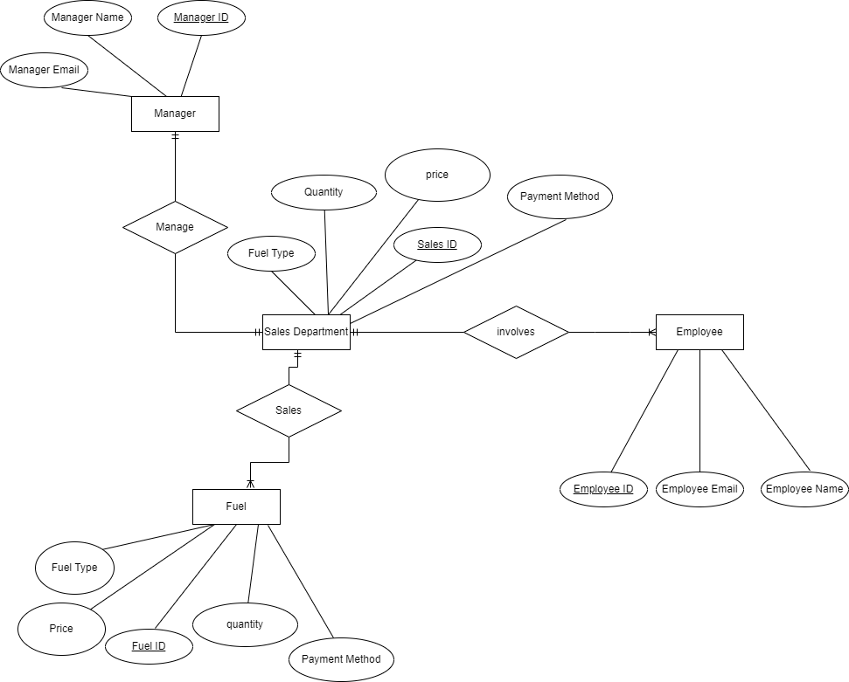
ERD

Slide 18
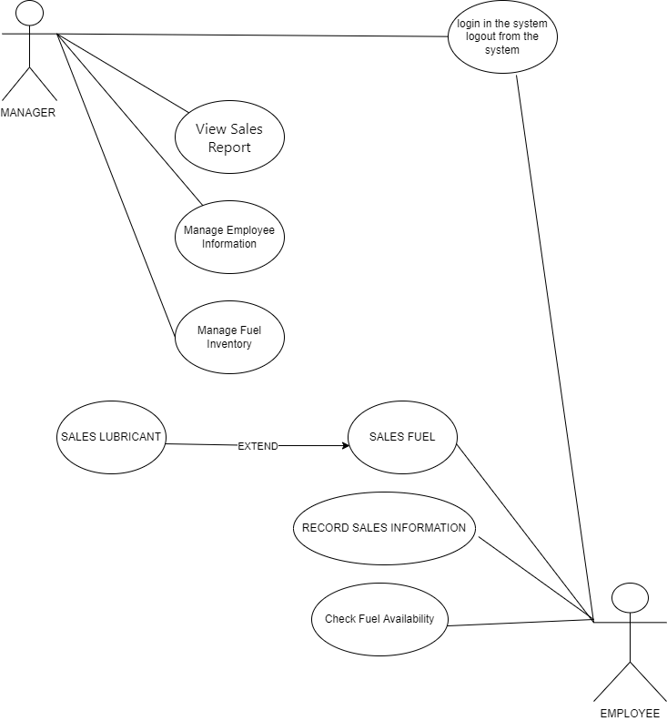
UCD

Slide 19
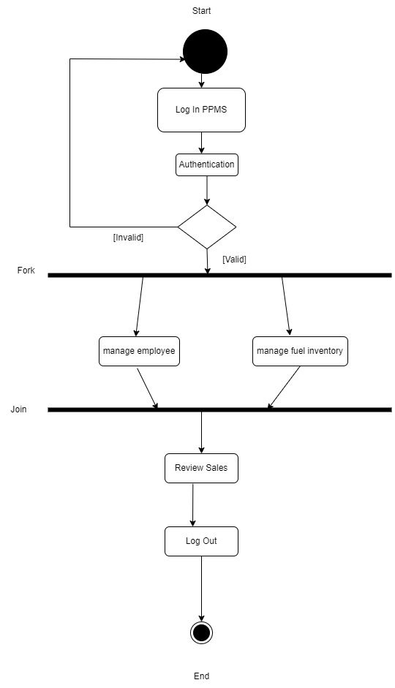
ACTIVITY DIAGRAM FOR MANAGER

Slide 20
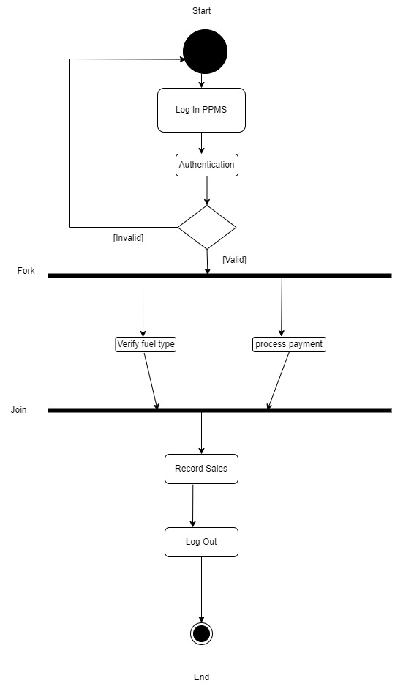
ACTIVITY DIAGRAM FOR EMPLOYEE

Slide 21
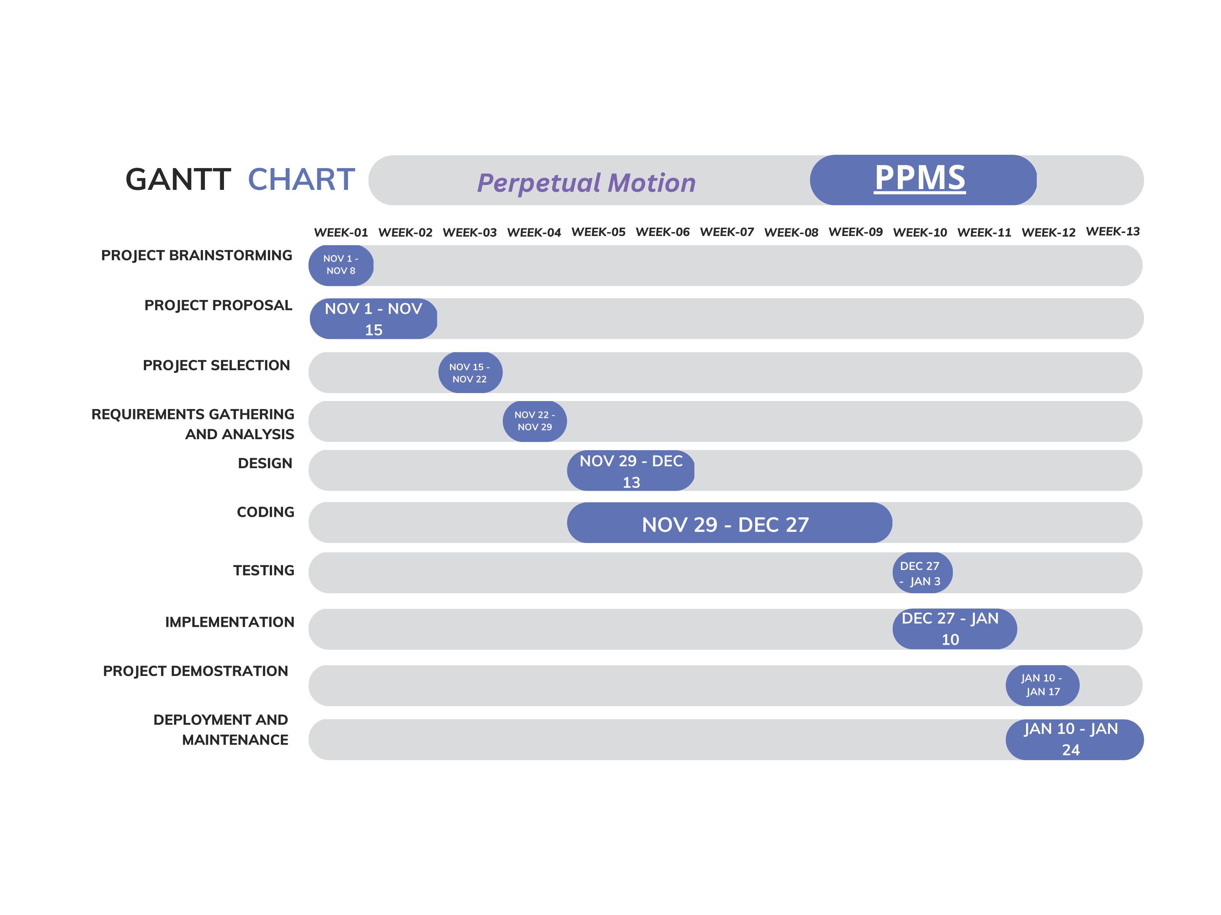
GANTT CHART

Slide 22
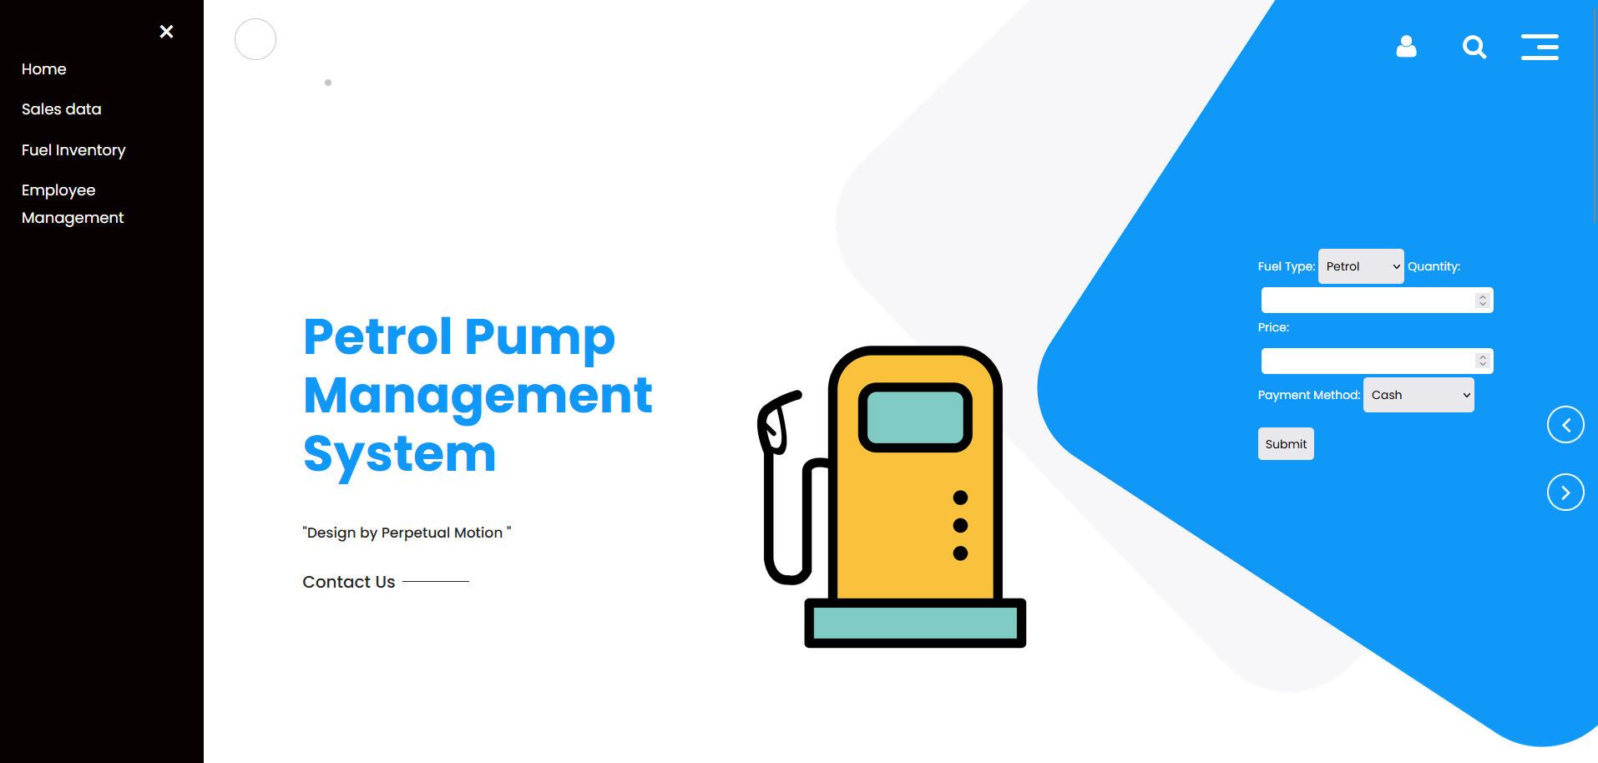

Slide 23
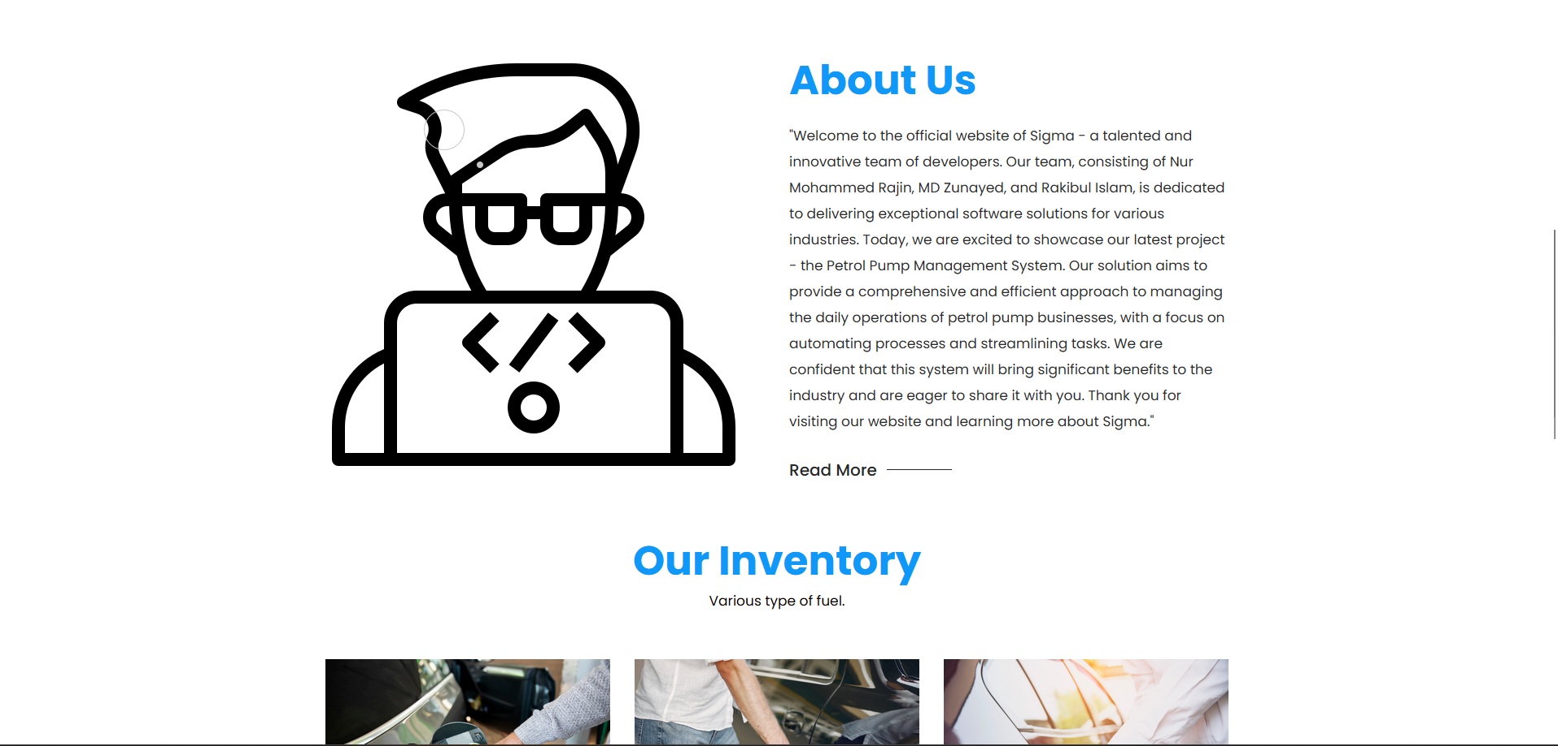

Slide 24
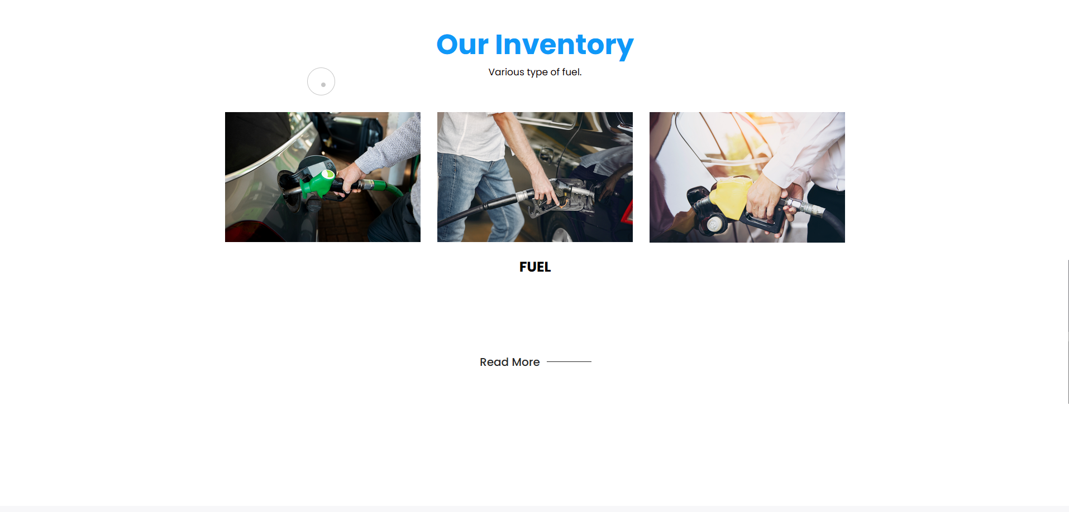

Slide 25
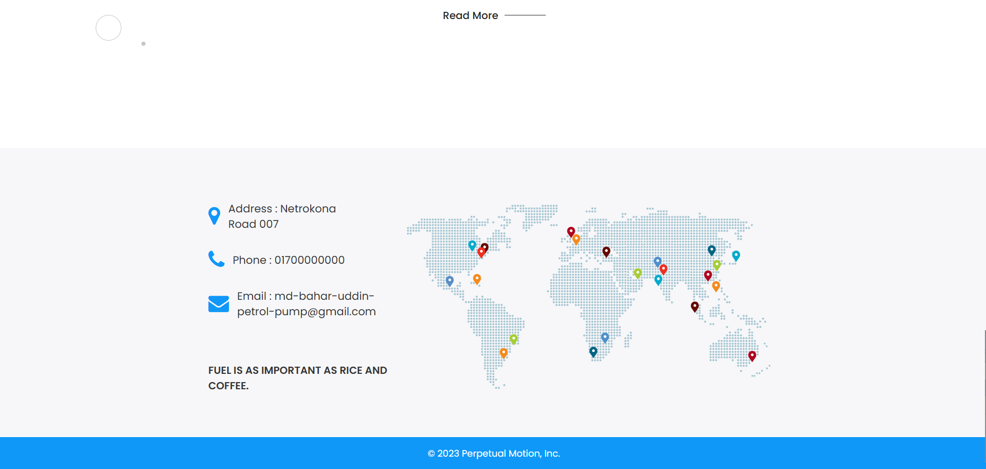

Slide 26

THANK YOU

